Slide 1
Advance React
Module 6

Slide 2
Advance React
React Hooks
React Hooks are in-built functions that allow React developers to use state and lifecycle methods inside functional components, they also work together with existing code, so they can easily be adopted into a codebase. The way Hooks were pitched to the public was that they allow developers to use state in functional components but under the hood, Hooks are much more powerful than that. They allow React Developers to enjoy the following benefits:
Improved code reuse;
Better code composition;
Better defaults;
Sharing non-visual logic with the use of custom hooks;
Flexibility in moving up and down the components tree.

Slide 3
Advance React
There are two main rules that are strictly to be adhered to as stated by the React core team in which they outlined in the hooks proposal documentation.
Make sure to not use Hooks inside loops, conditions, or nested functions;
Only use Hooks from inside React Functions.

Slide 4
Advance React
Basic React Hooks #
There are 10 in-built hooks that was shipped with React 16.8 but the basic (commonly used) hooks include:
useState()
useEffect()
useContext()
useReducer()
useRef()
refer this article for further details about useState() and useEffect()
https://www.smashingmagazine.com/2020/04/react-hooks-api-guide/

Slide 5
Advance React
React Refs
Refs is the shorthand used for references in React.
Refs are a function provided by React to access the DOM element and the React element that you might have created on your own. They are used in cases where we want to change the value of a child component, without making use of props and all. They also provide us with good functionality as we can use callbacks with them.

Slide 6
Advance React
Think of refs as a direct connection between components and DOM elements or class components and their parent components. This connection provides us with the means to access elements/components without state updates and rerenders.
you should consider using refs when you need to:
Manage focus, text selection, or media playback.
Perform imperative animations.
Integrate with third-party DOM libraries.

Slide 7
Advance React
Refs are usually defined in the constructor of class components, or as variables at the top level of functional components, and then attached to an element in the render() function. Here is a bare-bones example where we are creating a ref and attaching it to an <input> element:

Slide 8
Advance React
class MyComponent extends React.Component {
constructor(props) {
super(props)
this.myRef = React.createRef();
}
...
render() {
return (
<>
<input
name="email"
onChange={this.onChange}
ref={this.myRef}
type="text"
</>
)
}
}

Slide 9
Advance React
Refs are created using React.createRef(), and are assigned to class properties. In the above example the ref is named myRef, which is then attached to an <input> DOM element.
Once a ref is attached to an element, that element can then be accessed and modified through the ref.
Adding a button to the previous example. We can then attach an onClick handler that will utilise myRef to focus the <input> element it is attached to:

Slide 10
Advance React
handleClick = () => {
this.myRef.current.focus();
}
render() {
return (
...
<button onClick={this.handleClick}>
Focus Email Input
</button>
</>
)
}

Slide 11
Advance React
By doing this we are in fact changing the state of an input element without any React state updates. This makes sense in the case of focussing an <input>— we wouldn’t want to re-render elements every time we focus / blur an input.

Slide 12
Advance React
UseEffect:
The word effect refers to a functional programming term called a "side effect".
Side effects are not predictable because they are actions which are performed with the "outside world."
We perform a side effect when we need to reach outside of our React components to do something. Performing a side effect, however, will not give us a predictable result.
Think about if we were to request data (like blog posts) from a server that has failed and instead of our post data, gives us a 500 status code response.

Slide 13
Advance React
Virtually all applications rely on side effects to work in one way or another, aside from the simplest applications.
Common side effects include:
Making a request to an API for data from a backend server
To interact with browser APIs (that is, to use document or window directly)
Using unpredictable timing functions like setTimeout or setInterval.
This is why useEffect exists: to provide a way to handle performing these side effects in what are otherwise pure React components.

Slide 14
Advance React
For example, if we wanted to change the title meta tag to display the user's name in their browser tab, we could do it within the component itself, but we shouldn't.
function User({ name }) {
document.title = name;
// This is a side effect. Don't do this in the component body!
return <h1>{name}</h1>;
}

Slide 15
Advance React
If we perform a side effect directly in our component body, it gets in the way of our React component's rendering.
Side effects should be separated from the rendering process. If we need to perform a side effect, it should strictly be done after our component renders.
This is what useEffect gives us.
In short, useEffect is a tool that lets us interact with the outside world but not affect the rendering or performance of the component that it's in.

Slide 16
Advance React
The basic syntax of useEffect is as follows:
// 1. import useEffect
import { useEffect } from 'react';
function MyComponent() {
// 2. call it above the returned JSX
// 3. pass two arguments to it: a function and an array
useEffect(() => {}, []);
// return ...
}

Slide 17
Advance React
The correct way to perform the side effect in our User component is as follows:
We import useEffect from "react"
We call it above the returned JSX in our component
We pass it two arguments: a function and an array
import { useEffect } from 'react';
function User({ name }) {
useEffect(() => {
document.title = name;
}, [name]);
return <h1>{name}</h1>;
}

Slide 18
Advance React
The function passed to useEffect is a callback function. This will be called after the component renders.
In this function, we can perform our side effects or multiple side effects if we want.
The second argument is an array, called the dependencies array. This array should include all of the values that our side effect relies upon.
In our example above, since we are changing the title based off of a value in the outer scope, name, we need to include that within the dependencies array.

Slide 19
Advance React
What this array will do is it will check and see if a value (in this case name) has changed between renders. If so, it will execute our use effect function again.
This makes sense because if the name changes, we want to display that changed name and therefore run our side effect again.

Slide 20
Advance React
React useEffect is a function that gets executed for 3 different React component lifecycles.
Those lifecycles are componentDidMount, componentDidUpdate, and componentWillUnmount lifecycles.
Basic usage of useEffect
import React, { useState } from 'react';
const App = () => {
const [message, setMessage] = useState('Hi there, how are you?');
return <h1>{message}</h1>
};
export default App;

Slide 21
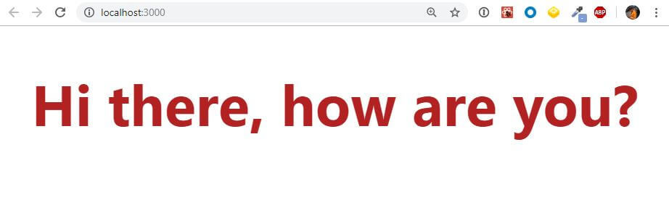
Advance React
using React useState to save a message.
grabbing state variable, message, and printing it to the screen.

Slide 22
Advance React
using useEffect to change the message a second after the component has mounted.
import React, { useState, useEffect } from 'react';
const App = () => {
const [message, setMessage] = useState('Hi there, how are you?');
useEffect(() => {
console.log('trigger use effect hook');
setTimeout(() => {
setMessage("I'm fine, thanks for asking.");
}, 1000)
})
return <h1>{message}</h1>
};
export default App;

Slide 23
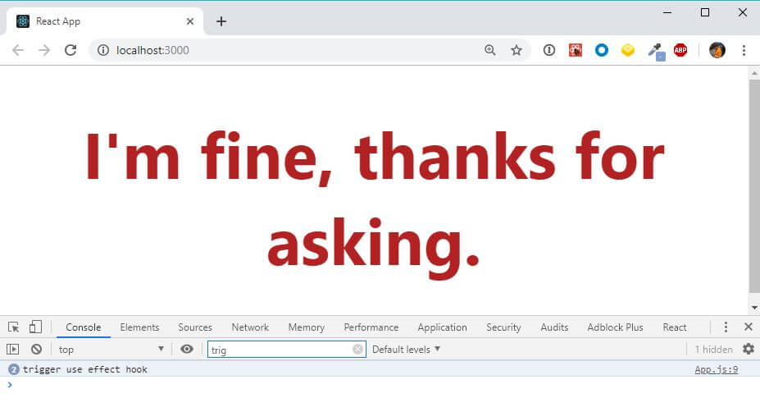
Advance React
useEffect has been imported from the React library and we have added my effect under the useState line.
useEffect accepts a function as it’s first argument. This function handler will take care of any side effects you like when it gets run.
The function is a callback function after one of the React component lifecycle has been triggered.

Slide 24
Advance React
MVC is covered in React Module.

Slide 25
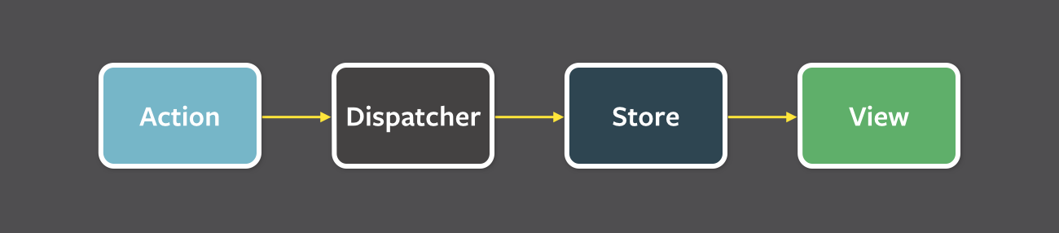
Advance React
React Flux

Slide 26
Advance React
If you have started working on ReactJS recently then you might be wondering how to manage state in React so that your application can scale.
To solve this state management issue, many companies and people have developed various solutions. Facebook, who developed ReactJS, came up with a solution called Flux.
What is flux?
Flux uses a unidirectional data flow pattern to solve state management complexity. Remember it is not a framework – rather it's more of a pattern that targets to solve the state management issue.
Are you wondering what's wrong with the existing MVC framework? Imagine your client's application scales up. You have interaction between many models and views. How would it look?

Slide 27
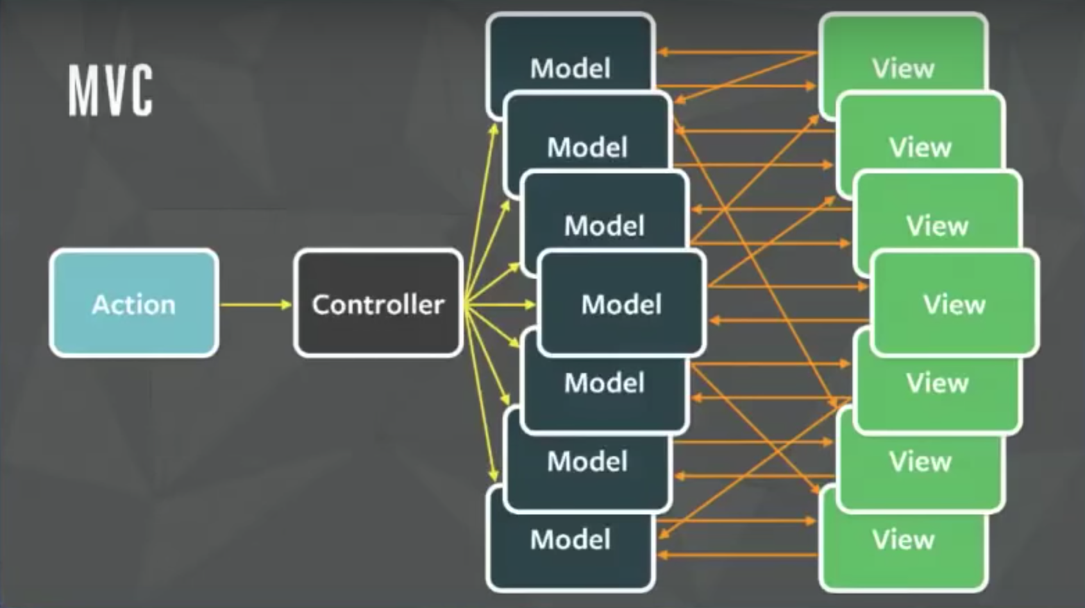
Advance React

Slide 28
Advance React
The relationship between components gets complicated. It becomes hard to scale the application. Facebook faced the same issue. To solve this issue they architected a Single directional data flow.

Slide 29
Advance React
As you can see from the image above, there are a lot of components used in Flux. Let's go through all the components one by one.
View: this component renders the UI. Whenever any user interaction occurs on it (like an event) then it fires off the action. Also when the Store informs the View that some change has occurred, it re-renders itself. For example, if a user clicks the Add button.
Action: this handles all the events. These events are passed by the view component. This layer is generally used to make API calls. Once the action is done it is dispatched using the Dispatcher. The action can be something like add a post, delete a post, or any other user interaction.

Slide 30
Advance React
The common structure of the payload for dispatching an event is as follows:
{
actionType: "",
data: {
title: "Understanding Flux step by step",
author: "Sharvin"
}
}
The actionType key is compulsory and it is used by the dispatcher to pass updates to the related store. It is also a known practice to use constants to hold the value name for actionType key so no typos occur. Data holds the event information that we want to dispatch from Action to Store. The name for this key can be anything.

Slide 31
Advance React
Dispatcher: this is the central hub and singleton registry. It dispatches the payload from Actions to Store. Also makes sure that there are no cascading effects when an action is dispatched to the store. It ensures that no other action happens before the data layer has completed processing and storing operations.
Consider this component has a traffic controller in the system. It is a centralized list of callbacks. It invokes the callback and broadcasts the payload it received from the action.
Due to this component, the data flow is predictable. Every action updates the specific store with the callback that is registered with the dispatcher.

Slide 32
Advance React
Store: this holds the app state and is a data layer of this pattern. Do not consider it as a model from MVC. An application can have one or many app stores. Stores get updated because they have a callback that is registered using the dispatcher.
Node's event emitter is used to update the store and broadcast the update to view. The view never directly updates the application state. It is updated because of the changes to the store.

Slide 33
Advance React
This is only part of Flux that can update the data. Interfaces implemented in the store are as follows:
The EventEmitter is extended to inform the view that store data has been updated.
Listeners like addChangeListener and removeChangeListener are added.
emitChange is used to emit the change.
Consider the below diagram with more stores and views. Still, the pattern and the flow of data will be the same. This is because this is a single direction and predictable data flow, unlike MVC or Two-way binding. This improves the data consistency and it's easier to find the bug.

Slide 34
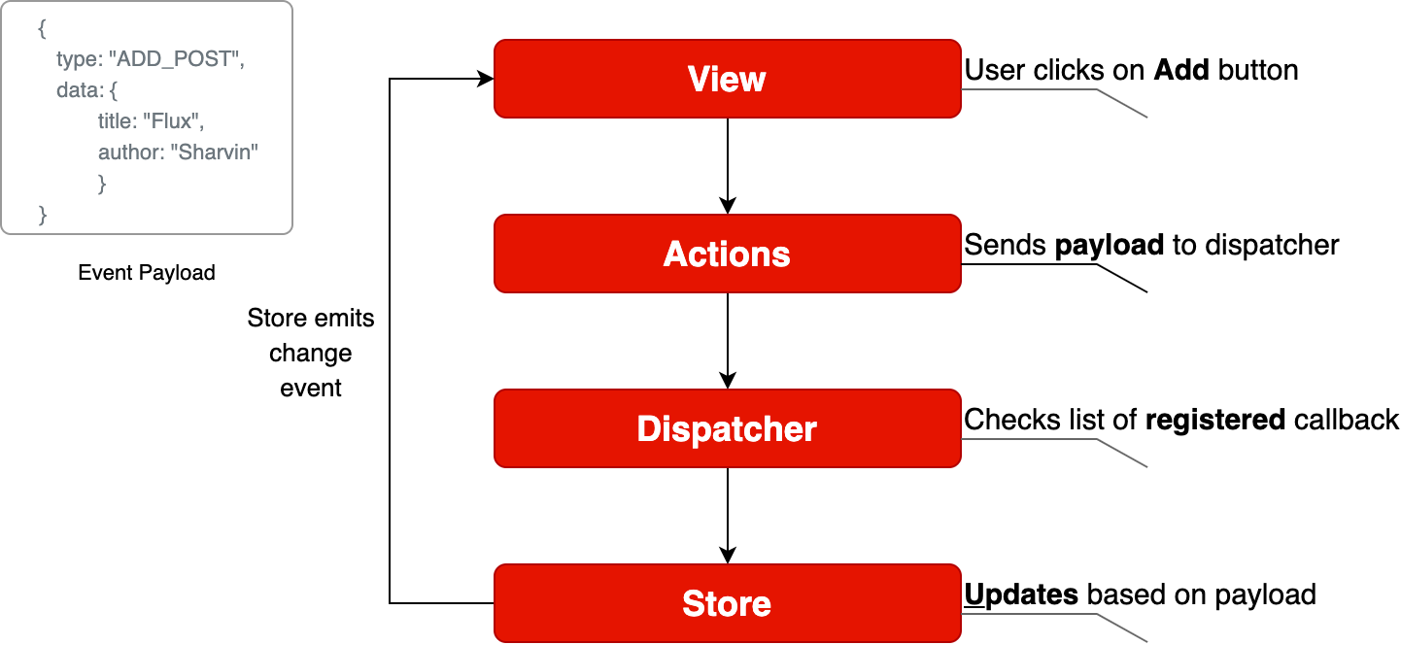
Advance React

Slide 35
Advance React
Well, Flux brings the following key benefits to the table with the help of unidirectional data flow:
The code becomes quite clear and easy to understand.
Easily testable using Unit Test.
Scalable apps can be built.
Predictable data flow.
Advantage of Flux
It is a unidirectional data flow model which is easy to understand.
It is open source and more of a design pattern than a formal framework like MVC architecture.
The flux application is easier to maintain.
The flux application parts are decoupled.

Slide 36
Advance React
Bundling the application and Web pack:
The React app bundled their files using tools like Webpack or Browserfy. Bundling is a process which takes multiple files and merges them into a single file, which is called a bundle. The bundle is responsible for loading an entire app at once on the webpage. We can understand it from the below example.
App.js
import { add } from './math.js';
console.log(add(16, 26)); // 42
math.js
export function add(a, b) {
return a + b;
}

Slide 37
Advance React
Bundle file as like below:
function add(a, b) {
return a + b;
}
console.log(add(16, 26)); // 42

Slide 38
Advance React
As our app grows, our bundle will grow too, especially when we are using large third-party libraries. If the bundle size gets large, it takes a long time to load on a webpage. For avoiding the large bundling, it?s good to start ?splitting? your bundle.
React 16.6.0, released in October 2018, and introduced a way of performing code splitting. Code-Splitting is a feature supported by Webpack and Browserify, which can create multiple bundles that can be dynamically loaded at runtime.
Code splitting uses React.lazy and Suspense tool/library, which helps you to load a dependency lazily and only load it when needed by the user.
The code splitting improves:
The performance of the app
The impact on memory
The downloaded Kilobytes (or Megabytes) size

Slide 39
Advance React
React.lazy
The best way for code splitting into the app is through the dynamic import() syntax. The React.lazy function allows us to render a dynamic import as a regular component.
Before
import ExampleComponent from './ExampleComponent';
function MyComponent() {
return (
<div>
<ExampleComponent />
</div>
);
}

Slide 40
Advance React
After
const ExampleComponent = React.lazy(() => import('./ExampleComponent'));
function MyComponent() {
return (
<div>
<ExampleComponent />
</div>
);
}
The above code snippet automatically loads the bundle which contains the ExampleComponent when the ExampleComponent gets rendered.

Slide 41
Advance React
Suspense
If the module which contains the ExampleComponent is not yet loaded by the function component(MyComponent), then we need to show some fallback content while we are waiting for it to load. We can do this using the suspense component. In other words, the suspense component is responsible for handling the output when the lazy component is fetched and rendered.
const ExampleComponent = React.lazy(() => import('./ ExampleComponent'));
function MyComponent() {
return (
<div>
<Suspense fallback={<div>Loading...</div>}>
<ExampleComponent />
</Suspense>
</div>
);
}

Slide 42
Advance React
The fallback prop accepts the React elements which you want to render while waiting for the component to load. We can combine multiple lazy components with a single Suspense component. It can be seen in the below example.
const ExampleComponent = React.lazy(() => import('./ ExampleComponent'));
const ExamComponent = React.lazy(() => import('./ ExamComponent'));
function MyComponent() {
return (
<div>
<Suspense fallback={<div>Loading...</div>}>
<section>
<ExampleComponent />
<ExamComponent />
</section>
</Suspense>
</div>
);
}

Slide 43
Advance React
Error boundaries
If any module fails to load, for example, due to network failure, we will get an error. We can handle these errors with Error Boundaries. Once we have created the Error Boundary, we can use it anywhere above our lazy components to display an error state.
import MyErrorBoundary from './MyErrorBoundary';
const ExampleComponent = React.lazy(() => import('./ ExampleComponent'));
const ExamComponent = React.lazy(() => import('./ ExamComponent'));
const MyComponent = () => (
<div>
<MyErrorBoundary>
<Suspense fallback={<div>Loading...</div>}>
<section>
<ExampleComponent />
<ExamComponent />
</section>
</Suspense>
</MyErrorBoundary>
</div>
);

Slide 44
Advance React
Route-based code splitting
It is very tricky to decide where we introduce code splitting in the app. For this, we have to make sure that we choose the place which will split the bundles evenly without disrupting the user experience.
The route is the best place to start the code splitting. Route based code splitting is essential during the page transitions on the web, which takes some amount of time to load. Here is an example of how to setup route-based code splitting into the app using React Router with React.lazy.

Slide 45
Advance React
import { Switch, BrowserRouter as Router, Route} from 'react-router-dom';
import React, { Suspense, lazy } from 'react';
const Home = lazy(() => import('./routes/Home'));
const About = lazy(() => import('./routes/About'));
const Contact = lazy(() => import('./routes/Contact'));
const App = () => (
<Router>
<Suspense fallback={<div>Loading...</div>}>
<Switch>
<Route exact path="/" component={Home}/>
<Route path="/about" component={About}/>
<Route path="/contact" component={Contact}/>
</Switch>
</Suspense>
</Router>
);

Slide 46
Advance React
Named Export
Currently, React.lazy supports default exports only. If any module you want to import using named exports, you need to create an intermediate module that re-exports it as the default. We can understand it from the below example.
ExampleComponents.js
export const MyFirstComponent = /* ... */;
export const MySecondComponent = /* ... */;
MyFirstComponent.js
export { MyFirstComponent as default } from "./ExampleComponents.js";
MyApp.js
import React, { lazy } from 'react';
const MyFirstComponent = lazy(() => import("./MyFirstComponent.js"));

